Slide 1
TOPIC - DBSCAN
By - Aniket Yadav
Roll - 69
PRN - 0120190328
Seat No - T204072

Slide 2
What is Machine learning?
A branch of artificial intelligence, concerned with the design and development of algorithms that allow computers to evolve behaviors based on empirical (past experience data) data.
Machine learning is a branch of artificial intelligence that employs a variety of statistical, probabilistic and optimization techniques that allows computers to “learn” from past examples and to detect hard-to-discern patterns from large, noisy or complex data sets.
As intelligence requires knowledge, it is necessary for the computers to acquire knowledge.

Slide 3
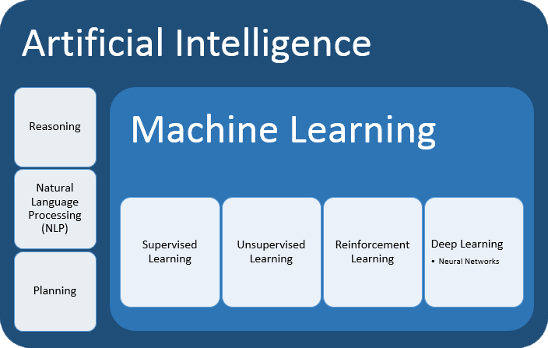
Types of Machine Learning
1.Supervised Learning
Classification
Regression
2.Unsupervised Learning
Clustering
3.Reinforcement Learning
Feedback/ Reward

Slide 4
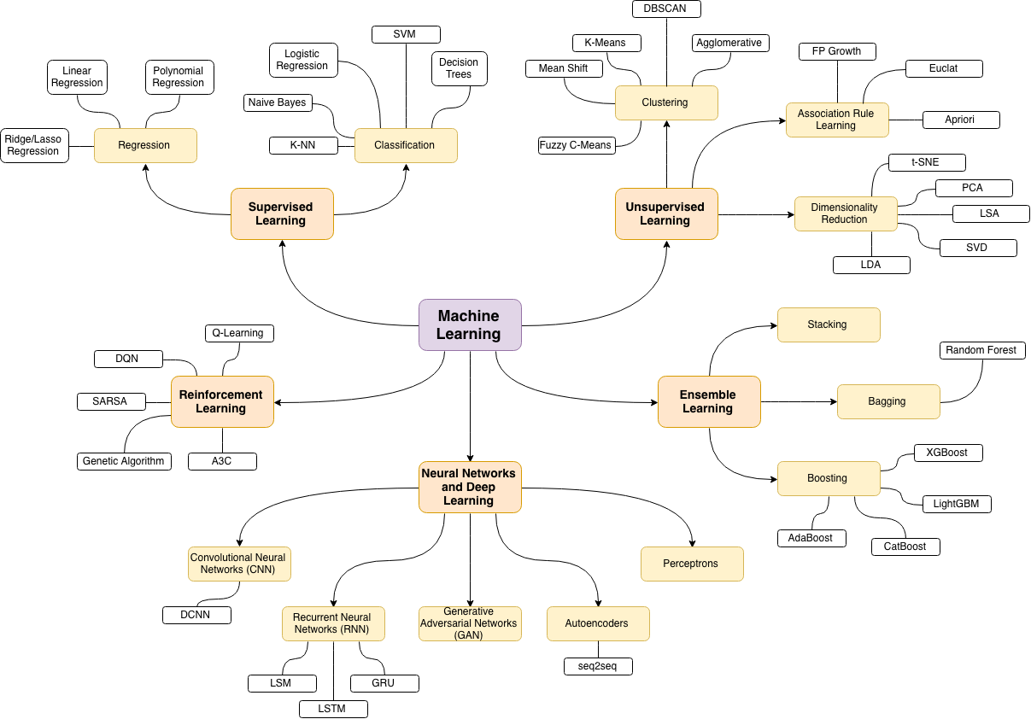

Slide 5
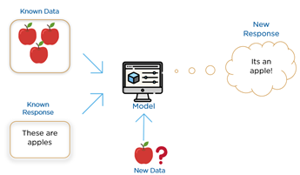
Supervised Learning
Given data in the form of examples with labels, we can feed a learning algorithm these example-label pairs one by one, allowing the algorithm to predict the label for each example, and giving it feedback as to whether it predicted the right answer or not.
Over time, the algorithm will learn to approximate the exact nature of the relationship between examples and their labels.
When fully-trained, the supervised learning algorithm will be able to observe a new, never-before-seen example and predict a good label for it.

Slide 6
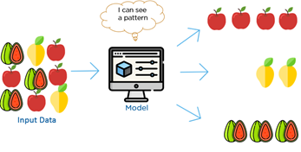
Unsupervised Learning
Unsupervised learning is very much the opposite of supervised learning.
It features no labels. Instead, our algorithm would be fed a lot of data and given the tools to understand the properties of the data.
From there, it can learn to group, cluster, and/or organize the data in a way such that a human (or other intelligent algorithm) can come in and make sense of the newly organized data.

Slide 7
DBSCAN Algorithm
DBSCAN stands for density-based spatial clustering of applications with noise. It is able to find arbitrary shaped clusters and clusters with noise (i.e. outliers).
There are two key parameters of DBSCAN:
eps: The distance that specifies the neighbourhoods. Two points are considered to be neighbours if the distance between them are less than or equal to eps.
minPts: Minimum number of data points to define a cluster.

Slide 8
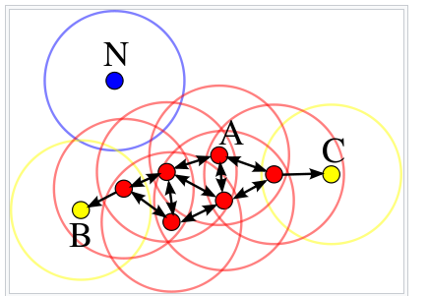
Based on these two parameters, points are classified as core point, border point, or outlier:
Core point: A point is a core point if there are at least minPts number of points (including the point itself) in its surrounding area with radius eps.
Border point: A point is a border point if it is reachable from a core point and there are less than minPts number of points within its surrounding area.
Outlier: A point is an outlier if it is not a core point and not reachable from any core points.

Slide 9
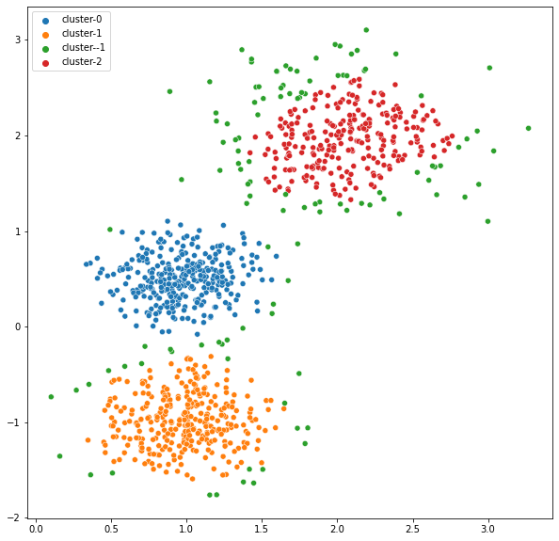
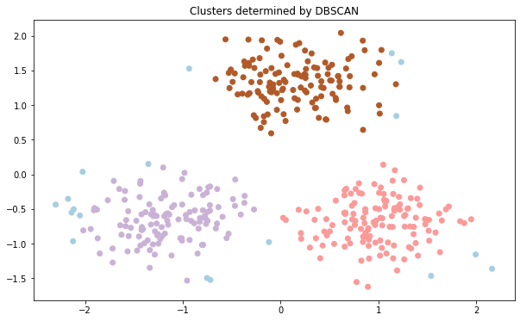
Sample Implementation

Slide 10
Advantages
1) Does not require a-priori specification of number of clusters.
2) Able to identify noise data while clustering.
3) DBSCAN algorithm is able to find arbitrarily size and arbitrarily shaped clusters.
Disadvantages
1) DBSCAN algorithm fails in case of varying density clusters.
2) Fails in case of neck type of dataset.
Does not work well in case of high dimensional data.

Slide 11
THANK YOU

